Slide 1
THE DIVISION OF DRINKING WATER (DDW)
Governed by a nine-member board that establishes the rules
Five Sections
  Administrative Services
  Rules
  Engineering
  Construction Assistance
  Field Services
www.drinkingwater.utah.gov

Slide 2
DDW REGULATES PUBLIC WATER SYSTEMS
Public Water Systems (PWS):
  Have 15 services connections AND/OR
  Serve at least 25 people (or 8 service connections) for 60 days

Slide 3
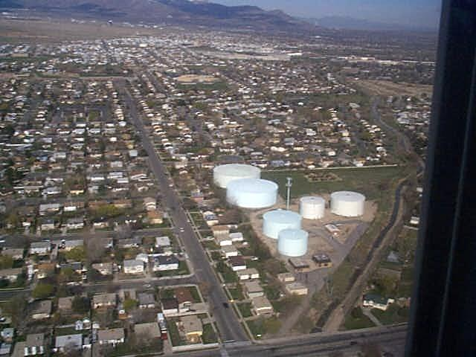
COMMUNITY SYSTEMS (COM)
Serve year-round residents
Long-term exposure, most stringent sampling requirements
Municipalities, districts
Utah has 474 COM systems.

Slide 4
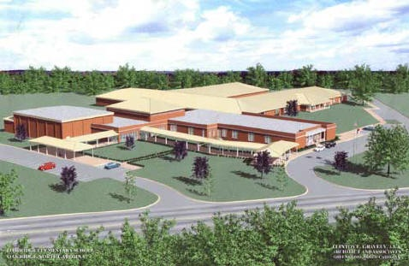
NONTRANSIENT NONCOMMUNITY SYSTEMS (NTNC)
Serve the same people for at least 6 months out of the year
Industry, rural schools
Sampling is less stringent than COM systems.
Utah has 68 NTNC systems

Slide 5
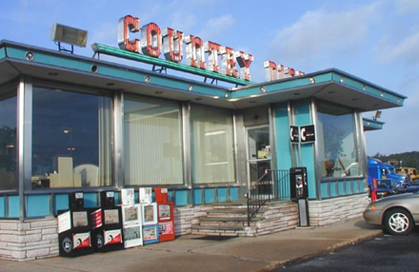
TRANSIENT NONCOMMUNITY SYSTEMS (TNC)
Serve different people
Are not active year round
Short-term exposure
Least stringent sampling requirements
Campgrounds, rest stops, churches, restaurants
Utah has 485 TNC systems.

Slide 6
PWS REQUIREMENTS
Construction Standards
Operational Requirements
Surface Water Treatment Rule
Sanitary Surveys/Improvement Priority Rule
Cross Connection Control
Source Protection
Monitoring & Reporting, Water Quality
Public Notice
Operator Certification (except TNC systems)
Private systems are NOT regulated by DDW

Slide 7
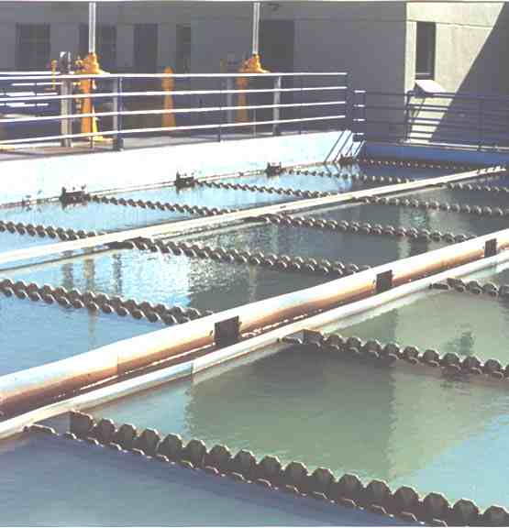
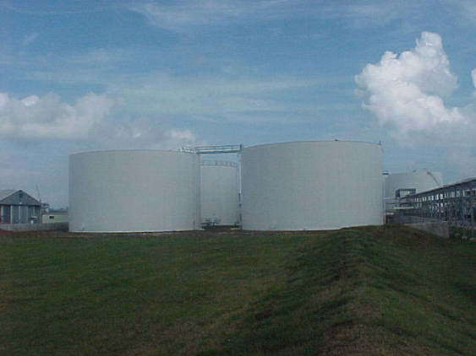
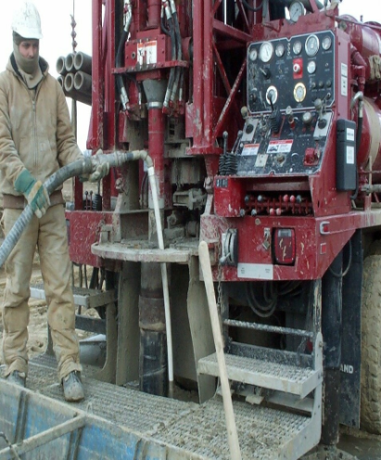
CONSTRUCTION STANDARDS
Purpose: to provide a safe and reliable supply of drinking water.
Apply to: Source development, water treatment, water quantity, water storage, pump stations, and distribution systems.
Plans for drinking water projects must be submitted to DDW for review.

Slide 8
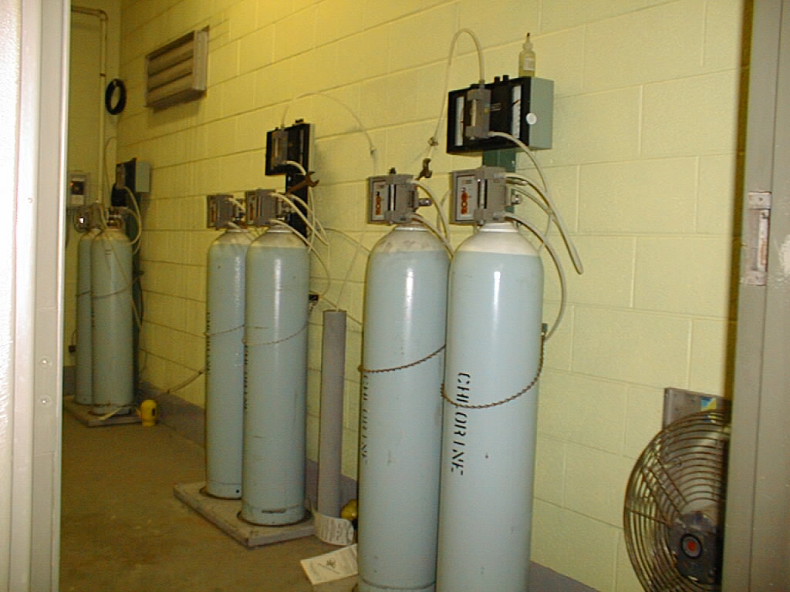
Intake
Ammonia
Exhaust Fan
Chlorination building. The air intake is at the top, and the exhaust is near the floor. The ammonia bottle is required.

Slide 9
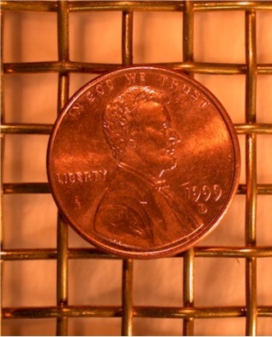
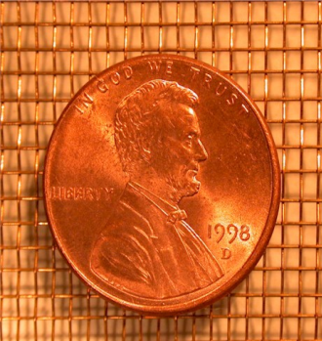
CONSTRUCTION STANDARDS - EXAMPLES
Proper sizing of source, storage, transmission and distribution piping to meet demands.
Flowing wells must be controlled by a valve.
Storage tank access lids must be locked.
Free flowing wells must be controlled by valves.
All vents, overflows and drains must be screened
  Air vents must have a #14 mesh screen
  Water outlets must have a #4 mesh screen
#4 mesh
#14 mesh

Slide 10
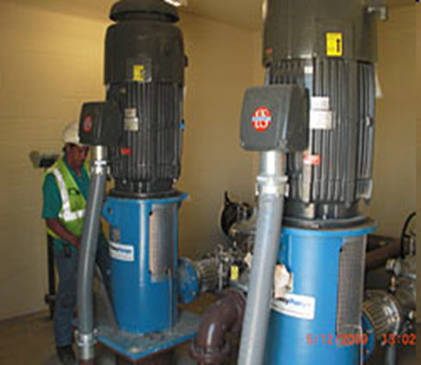
CONSTRUCTION STANDARDS - EXAMPLES
Finished water storage must be covered.
Sewer lines must be at least 50 feet from storage reservoirs.
Sewer lines must be at least 10 feet from waterlines, and 18 inches below waterlines.
Pumping stations must have 2 complete pumps, and each pump must provide the maximum flow of the station.

Slide 11
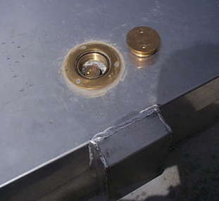
CONSTRUCTION STANDARDS - EXAMPLES
Access Hatch Lids for Tanks and Springs
  The access hatch lids must be a shoebox type lid.
  The lid must overlap 2 inches.
  There must be a gasket between the lid and the frame.

Slide 12
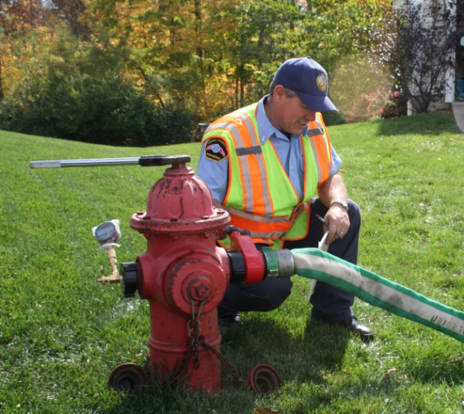
CONSTRUCTION STANDARDS - PRESSURE
Pressure
  For PWS approved before January 1, 2007:
    Maintain 20 psi minimum dynamic pressure at all locations during normal operation.
    Meet the new minimum pressures in new service areas.
  For new construction after January 1, 2007 at the points of connection:
    20 psi with fire flow during peak day demand
    30 psi during peak instantaneous demand
    40 psi during peak day demand
  Individual home booster pumps are NOT ALLOWED unless an exception is granted by the Division Director.

Slide 13
CONSTRUCTION STANDARDS - EXCEPTIONS
Requesting an Exception
  If a facility meets the intent of the rule but cannot meet the construction standards, then they submit an exception request to the Division Director in writing.
  It must include:
    The rule citation
    An explanation of why the rule cannot be met
    What the system proposes in lieu of the rule
    Justifications

Slide 14
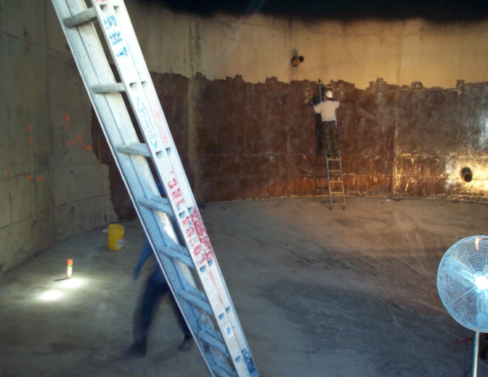
CONSTRUCTION – PLAN REVIEW
Required for “construction, addition, and modification” of drinking water facilities.
Examples
  Recoat a water tank interior
  Change or add a chemical
  Redevelop a source
  Add a booster pump, PRV, or chlorinator
  Construction of tanks, pump stations, pipelines, sources, treatment plants, etc.
Plan review is required. There is no construction until Plan Approval is issued.

Slide 15
CONSTRUCTION – PLAN REVIEW
Submit a “project notification form.”
Submit plans and specifications to obtain Plan Approval. (Plan on 30 days for the review process.)
Complete construction.
Obtain an Operating Permit before placing the facility in service. Otherwise, 50 to 150 deficiency points could be assessed.
  This includes submitting as-built drawings, satisfactory bacteria results, etc.

Slide 16
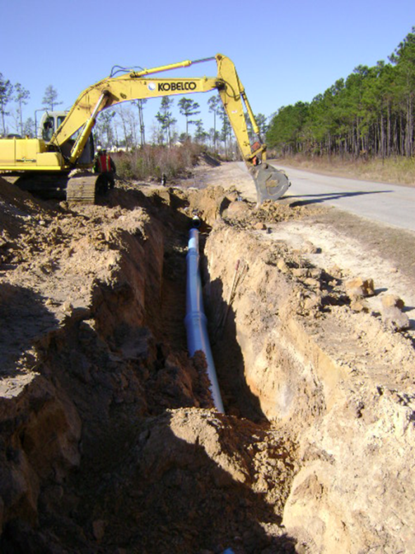
CONSTRUCTION – PLAN REVIEW
Plan Review is NOT required for certain O&M procedures such as:
  Repair leaky pipelines
  Replace existing pipeline of the same size or upgrade to meet minimum size requirement
  Add new pipeline <500 feet at a time or <1,000 feet per year
  Inspect, clean, and maintain a tank
  Tap existing water mains to connect new service laterals
  Replace a pump of the same type, size, and rated capacity

Slide 17
OPERATIONAL REQUIREMENTS
Contaminated facilities must be disinfected before being placed back into service.
AWWA disinfection standards (50 ppm chlorine)
  C651 Water mains
  C652 Storage tanks
  C653 Water treatment plants
  C654 Wells
Added chemicals must meet National Sanitation Foundation (NSF) Standard 60.
Deep-rooted vegetation in a spring collection area must be mechanically cleaned.

Slide 18
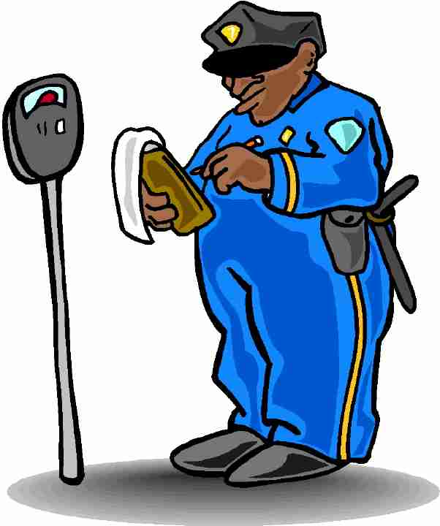
IMPROVEMENT PRIORITY SYSTEM (IPS)
The way DDW measures the condition and performance of a PWS, based on quality, monitoring, public notification, physical deficiencies, operator certification, cross connection control, and source protection.
The more demerit points a PWS has, the worse off it is!

Slide 19
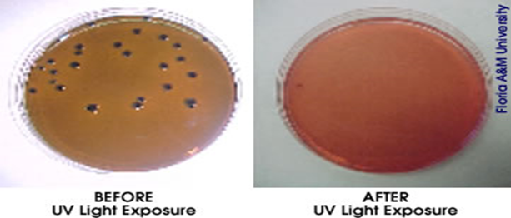
IMPROVEMENT PRIORITY SYSTEM (IPS)
Points are assessed for deficiencies and violations.
The amount of points assessed is based on the threat to the water quality and public health.
  Confirmed E.coli contamination = 50 points
  Missing a smooth- nosed sampling tap on well discharge piping = 1 point

Slide 20
IMPROVEMENT PRIORITY SYSTEM (IPS)
Thresholds:
  COM 150 pts
  NTNC 120 pts
  TNC 100 pts
For an approved rating, a PWS must have LESS than the thresholds above.
  RATINGS
Approved:
  In good compliance
Corrective Action:
  Provisional rating for a PWS that is working on compliance
Not Approved:
  PWS does not fully comply with the rules

Slide 21
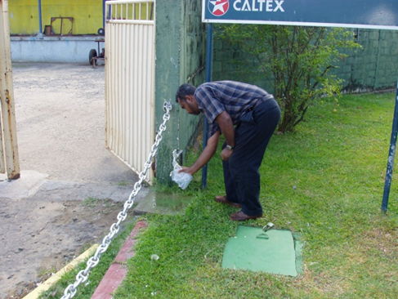
IMPROVEMENT PRIORITY SYSTEM (IPS)
Points are added:
  At the time of the sanitary survey
  When the PWS fails to sample
  There is a quality problem
Points are deleted:
  When the physical deficiencies are fixed
  When samples are taken
  For coliform, the IPS points stay on for 12 months or 4 consecutive quarters of operation.

Slide 22

IMPROVEMENT PRIORITY SYSTEM (IPS)
Sanitary Survey
  During the survey points are given for physical facility deficiencies.
  A time period is given for the problem to be fixed before the points are activated.
  Points are only given once for a repeating deficiency.
  Some deficiencies may be grandfathered if they will not impact public health. (See Exceptions in Construction Standards.)

Slide 23
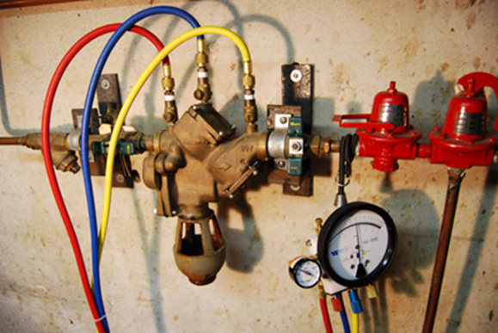
CROSS-CONNECTION CONTROL
There are 5 required components:
Local Authority: Identifies a person to administer the program, must require protection for cross connections, must require periodic testing of all backflow prevention assemblies, must require hazard assessments, identifies and authorizes enforcement methods, requires inspection of new construction and existing privately-owned PWS.

Slide 24

CROSS-CONNECTION CONTROL
Public Awareness/Education: bill
Stuffers, newspaper, town meetings,
consumer confidence reports
Trained or Certified Staff: ABPA evening seminars, backflow certification course, Rural Water seminars
Records of Program Activities: Inventory of testable assemblies, inventory of health (high) hazard air gaps, records of hazard assessment surveys, records of enforcement actions

Slide 25
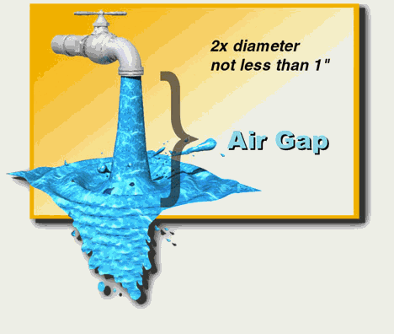
CROSS-CONNECTION CONTROL
Ongoing Enforcement: Hazard assessment surveys/appropriate protection provided, tracking annual testing of devices, continues public education, assemblies tested annually

Slide 26
CROSS-CONNECTION CONTROL
Degree of Hazard Protection
Sewage: Air gap - minimum 1” or twice the diameter of the pipe & best form of CCC
High Hazard: Backpressure or backsiphonage, requires Reduced Pressure (RP) backflow assembly
High Hazard: Backsiphonage only, requires Pressure Vacuum Breaker (PVB) assembly, spill resistant vacuum (SVB) breaker assembly or atmosphere vacuum breaker device (AVB)
Low Hazard: Backpressure of backsiphonage, requires double check valve
Low Hazard: Backsiphonage only, requires PVB, SVB, or AVB

Slide 27
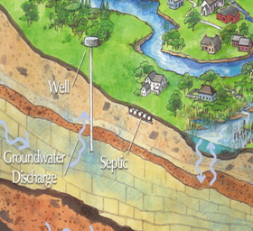
SOURCE PROTECTION PLANS
Required for all new sources for all PWS, but TNC sources built before 1993 are exempt.
  TNC systems have Source Water Assessments
There are five required components:
  Identify a designated person
  Inventory all potential sources of contamination
  Management plan to manage and prevent contamination
  Contingency plan
  Source delineation

Slide 28
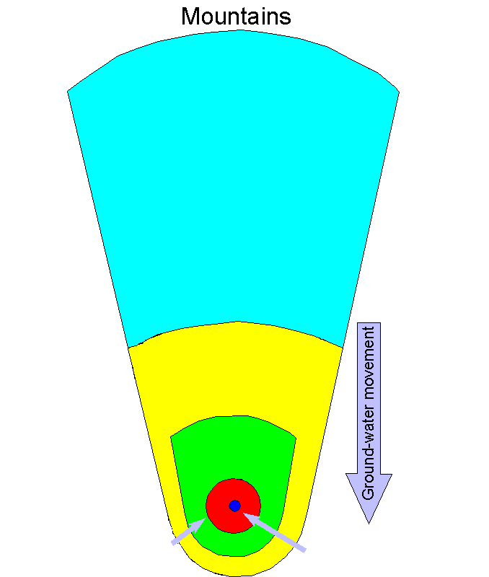
SOURCE PROTECTION PLANS
Delineation
  Zone 1 = 100-ft radius
  Zone 2 = 250-day time of travel
  Zone 3 = 3-year time of travel
  Zone 4 = 15-year time of travel
  *Optional 2 mile radius

Slide 29
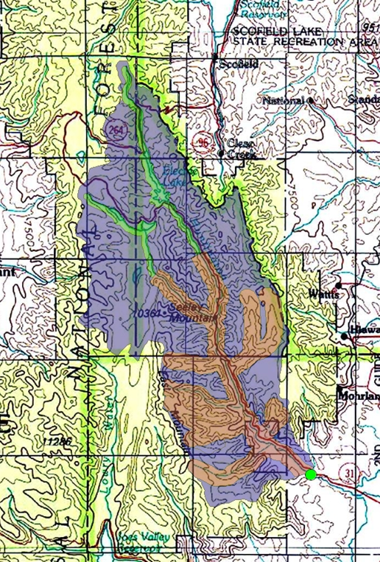
SOURCE PROTECTION PLANS
Surface Water Zones
  Zone 1 = ½ mile from High Water Mark (HWM), 100 ft downstream to 15 miles upstream
  Zone 2 = 1,000 ft from HWM, additional 50 miles upstream
  Zone 3 = 500 ft from HWM
  Zone 4 = remainder of watershed or state line

Slide 30
SOURCE PROTECTION PLANS
Monitoring reduction waivers for VOCs and pesticides
There is an implementation schedule for the plan.
There is a resource evaluation that lists resources to implement the plan.
The contingency plan includes all drinking water sources.
Must notify the public of your source protection plan, usually a part of the consumer confidence report (CCR).

Slide 31
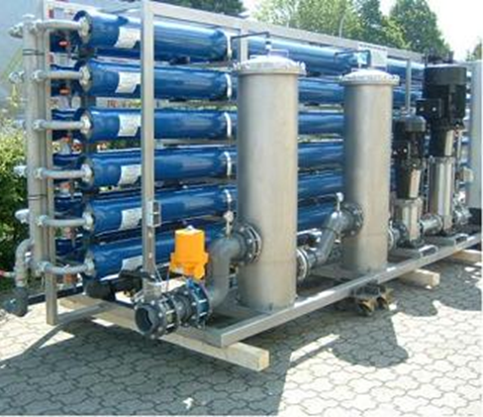
WATER QUALITY
Primary Drinking Water Standards
  Health based, sampling is required
Secondary Drinking Water Standards
  Aesthetic based, sampling is not required
Treatment Technique
  Only for surface water
  treatment systems
Action Levels
  Only for lead/copper

Slide 32

WATER QUALITY –
VARIANCES & EXEMPTIONS
Variances & exemptions are not available for total coliform and surface water treatment.
A variance or exemption must not result in an unreasonable risk to human health.
Variances are based on raw water quality.
Exemptions are based on availability of feasible treatment.
Additional time is given to meet the MCL or BAT (best available technology).

Slide 33
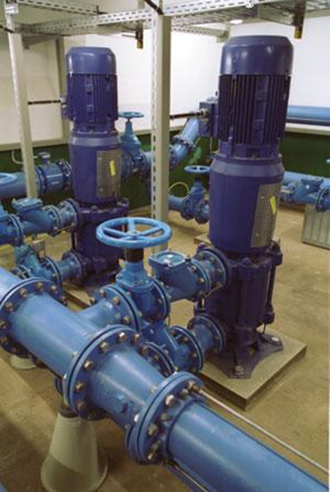
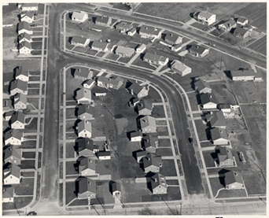
WATER QUALITY - MONITORING
Distribution
  Coliform bacteria
  Lead & Copper
  Asbestos
  Disinfection Byproducts
Source
  Asbestos
  Inorganics & Metals
  Nitrate, Nitrite
  Sulfate
  VOCs
  Pesticides
  Radionuclides

Slide 34

WATER QUALITY – COLIFORM BACTERIA
Coliform bacteria is an indicator bacteria
Coliform is a family of bacteria. Some cause illness; others do not.
All samples are tested for Escherichia coli (E. coli)
All PWS must sample monthly.
The number of samples required depends on the system population.
PWS keeps records of coliform results for 5 years.

Slide 35
WATER QUALITY – COLIFORM BACTERIA
Community | Sample every month The # of samples depends on population
Nontransient Noncommunity (NTNC)
Noncommunity (NC)

Slide 36
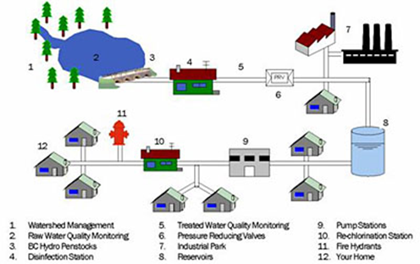
WATER QUALITY – COLIFORM BACTERIA
Sampling Site Plan
  A plan that shows the PWS is rotating its samples throughout representative sites in the system.
  Must be written, submitted to DDW and is reviewed during the sanitary survey.
  A PWS must have at least 5 sites in the plan or twice the # of samples required.
  PWS that collects >5 samples per month should not collect them on the same day day.
  The PWS is responsible for for taking coliform samples.

Slide 37
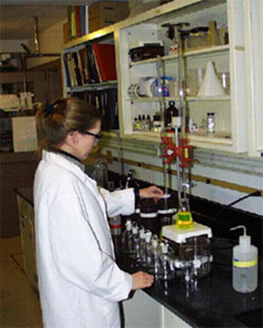
WATER QUALITY – COLIFORM BACTERIA
You take the routine sample and send it to the lab.
The lab will mark the results:
  Satisfactory (TC -)
  Unsatisfactory (TC + EC -, or TC + EC +)
  Indeterminate (interfering bacteria, PWS must take another routine sample within 24 hours.)
If the results are satisfactory, then no further action is required.
If the results are unsatisfactory, you must take repeat, triggered and possibly investigative samples.

Slide 38
WATER QUALITY – COLIFORM BACTERIA
Types of Samples
ROUTINE = The routine samples required monthly .
REPEAT = Samples taken in the distribution system after an unsatisfactory routine. They must be pulled from within 5 service connections upstream & downstream and one at the original site.
TRIGGERED = For groundwater PWS, these samples are taken at all groundwater sources in use. If a groundwater PWS purchases water, then the wholesale system must be notified so they can take these samples at their sources.
CONFIRMATION= Taken when Triggered GW source sample is E.coli positive.
INVESTIGATIVE= Samples taken to identify a potential problem, but do not count toward samples required by monitoring schedule

Slide 39
WATER QUALITY – COLIFORM BACTERIA
If the result is unsatisfactory:
  The lab analyzes for E.coli (EC).
  PWS takes REPEAT, and groundwater systems take TRIGGERED samples within 24 hours of notification.
How many repeats do I take?
  All systems take 3 repeat samples
    Original sample site
    5 Connections upstream
    5 Connections downstream

Slide 40
WATER QUALITY – COLIFORM BACTERIA
Violations for the Revised Total Coliform Rule
Monitoring Violations:
  Failure to take routines or triggered samples
  Failure to take repeat samples results in assessment requirement
Quality Violations:
  Acute violations are confirmed E.coli contamination.
    Mandatory health effects language with public notice

Slide 41
WATER QUALITY – COLIFORM BACTERIA
Violations for the Revised Total Coliform Rule
Treatment Technique Violations:
  Failure to conduct a Level 1 or 2 Assessment
  Failure to correct significant deficiencies
  Failure to perform seasonal start-up procedures
Reporting Violation:
  Failure to report results (whether they are taken or not)
  Failure to report seasonal start-up procedures
  Failure to report a Level 1 or 2 Assessment

Slide 42
WATER QUALITY – COLIFORM BACTERIA
Acute Violations: at two points in time (routine, repeat) a PWS has at least one TC+ and one EC+.
ROUTINE | REPEAT | Violation | Triggers
TC+ EC- | TC+EC- | No Violation | Level 1 or 2 Assessment
TC+ EC- | TC+ EC? | E.coli MCL Violation | Failure to test for E.coli results MCL and an assessment
TC+ EC- | TC+ EC+ | E.coli MCL Violation | Level 1 or 2 Assessment
TC+ EC- | Missed Any Repeat Samples | No MCL Violation | Level 1 or 2 Assessment
TC+ EC+ | TC+ | E.coli MCL Violation | Level 2 Assessment
TC+ EC+ | TC+ EC+ | E. coli MCL Violation | Level 2 Assessment
Notes:
EC?=Failure to speciate e.coli

Slide 43
Seasonal Systems
Seasonal Systems: Systems that are only open part of the year. Meaning NO WATER IS SERVED DURING THEIR CLOSED PERIOD
Required to perform and report start-up procedure before opening
  Inspect
  Flush
  Disinfect
  Clean INVESTIGATIVE bacteria sample
  Report process to DDW

Slide 44
Level 1 Assessments
Triggered By
  TC+ Samples
    PWS that take <40 routines = more than 1 TC+ sample in a month
    PWS that take >40 routines = more than 5% TC+ samples in a month
  Failure to take repeat samples after routine TC+EC-
Conducted by System
Results reported to DDW within 30 Days of Trigger

Slide 45
Level 2 Assessments
Triggered By
  An acute quality violation
  Failure to take repeat samples after routine TC+EC+
  A second Level 1 Assessment within a rolling 12 month period
Conducted By DDW or Authorized DDW Personnel
More In-depth Look At System

Slide 46
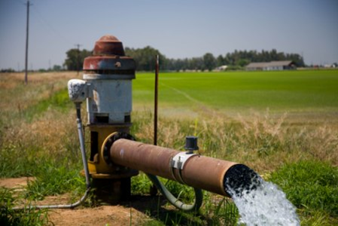
WATER QUALITY – GROUNDWATER RULE
Applies to PWS using groundwater, consecutive PWS receiving groundwater, and wholesale PWS using groundwater
Five Components
  Triggered samples at the source
  Assessment samples at the source
  Corrective actions
  Sanitary surveys
  Compliance monitoring

Slide 47
WATER QUALITY – GROUNDWATER RULE
1. Triggered Source Samples
  Required when a routine coliform sample is TC +
  How many?
    Take one for each active groundwater source
  What if the triggered sample is EC +?
    PWS takes 5 confirmation source samples.
  4 log treated sources are exempt from triggered source samples.

Slide 48

WATER QUALITY – GROUNDWATER RULE
2. Assessment Samples
  Required at DDW discretion for sensitive sources, such as redeveloped springs, sources with TC + history, sources without plan approval/operating permit
  A minimum of 12 monthly samples is required per source.
3. Corrective Actions
  Required when confirmed EC+ at the source
  Uncorrected significant physical deficiencies
  Required within 120 days, or
  the DDW-approved Corrective Action plan deadline

Slide 49
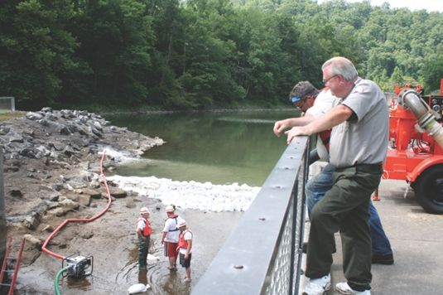
WATER QUALITY – GROUNDWATER RULE
4. Sanitary Surveys
  Required 8 elements for surveys
    Operation & maintenance, sources, treatment, finished water storage, pumps, operator certification, monitoring & reporting data verification, distribution system
  Water system should receive the sanitary survey report within 30 days.

Slide 50
WATER QUALITY – GROUNDWATER RULE
Compliance Monitoring
  Required only for sources with the 4-log exemption
  An engineering reviewed minimum dosage is required for 4-log exempt sources.
  Chlorine residual samples
    Over 3,300 population continuous monitoring
    Under 3,300 population daily grab samples
  Reporting is combined with quarterly DBP.

Slide 51
WATER QUALITY – GROUNDWATER RULE
  Violations:
  Monitoring
    Failure to collect triggered samples
    Failure to collect assessment samples
    Failure to collection additional source samples – default to required corrective action
    Failure to complete compliance monitoring
  Quality
    Failure to address confirmed E. coli at the source
    Failure to correct a significant deficiency or file a corrective action plan

Slide 52

WATER QUALITY – GROUNDWATER RULE
  Example Problem:
  Distribution system has 1 TC+ sample. What is the operator required to do?
    Collect repeat samples.
    Collect a sample at all active groundwater sources.
    Both a & b
    Examine the meter reading at the original sample site.

Slide 53
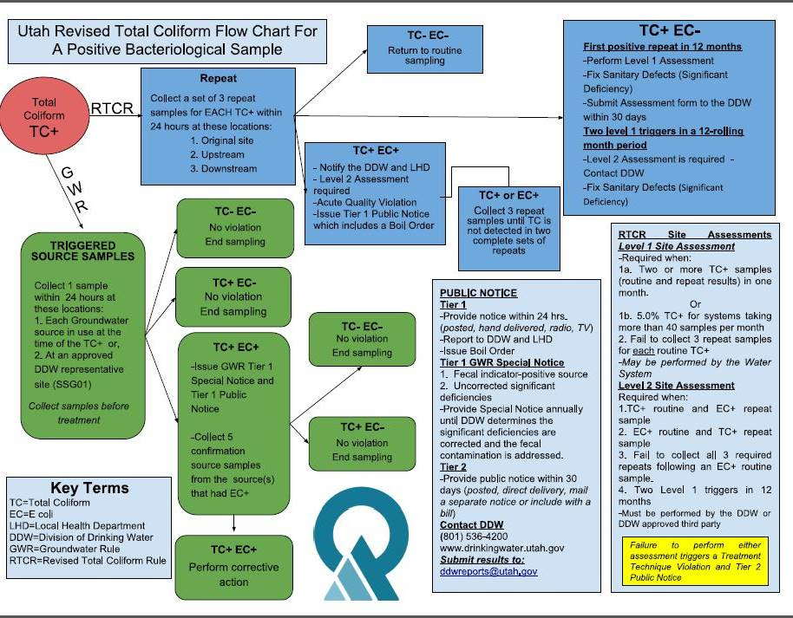

Slide 54
SURFACE WATER TREATMENT RULE
Surface Water must be treated. Chlorination alone is not sufficient for treating surface water.
Package plants must meet the same construction standards as large plants.
SW Treatment systems must submit a monthly report to DDW.
1. Filtration
2.Disinfection
3.Disinfectant Residual in DS

Slide 55
SURFACE WATER TREATMENT RULE
1. Filtration
Filtration provides a physical barrier to remove pathogens and particles
Maximum filter loading rate is 6 gal/min/ft2.
Turbidity – a measure of the filtration effectiveness
    Surface Water (SW) systems
        0.34 NTU in 95% of samples, never to exceed 1.0 NTU spike
        Sample turbidity at each individual filter effluent
        Sample the combined filter turbidity at the clear well
    Ground water turbidity = 5.0 NTU

Slide 56
SURFACE WATER TREATMENT RULE
2. Disinfection
  All surface water sources must be monitoring for either cryptosporidium or E. coli before all treatment to determine if additional treatment is needed.
  Disinfect to obtain treatment credits and additional Log inactivation
    99% or 2 log inactivation of crypto
    99.9% or 3 log inactivation of giardia, lamblia cysts
    99.99% or 4 log inactivation of enteric viruses

Slide 57
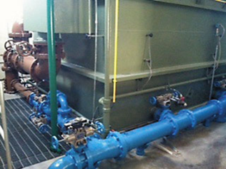
SURFACE WATER TREATMENT RULE
  3. Disinfectant Residual in DS
  Disinfectant CT = Concentration (C) x contact time (T)
  Contact time is required
  The chlorine residual leaving the plant must be = or > 0.2 mg/L and measurable throughout the system.
  Adequate disinfection is mandatory before the first customer.
  CT with mixing basins and storage tanks is determined by tracer studies or the equivalent.

Slide 58
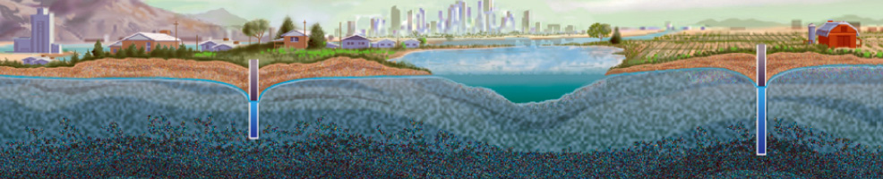
SURFACE WATER TREATMENT RULE
Groundwater may be “under the direct influence” (UDI) of surface water.
UDI is determined through a filter test called microscopic particulate analysis (MPA) that detects surface origin microorganisms such as algae or observations involving temperature, turbidity, alkalinity and volume, or geologic conditions.
Surface water treatment is required for UDI sources.

Slide 59
WATER QUALITY – LEAD & COPPER
Required for COM, NTNC
Must have a sampling site plan
Must give results of test to sample homes and certify to DDW that results have been given.
The number of required samples is based on population.
Samples taken from kitchen/bathroom cold water tap, first draw after sitting undisturbed for 6 hours.
  Not outside spigots, vacant homes or rarely used sinks!
Initial | Reduced | Further Reduced
Every 6 months for 2 rounds | Annually for 3 rounds | Every 3 years forever
EXAMPLE:
1st half 2002
2nd half 2002
Annual 2003
Annual 2004
Annual 2005
3 year 2008
3 year 2011

Slide 60
WATER QUALITY – LEAD & COPPER
Sample Sites:
Tier 1
  Single family homes with copper pipes 1982-1986
Tier 2
  Multiple family homes with copper pipes 1982-1986
Tier 3
  Homes before 1982 with metal pipes
Compliance:
Based on the 90th percentile result
Compare the 90th percentiles to the Action Levels
  Copper = 1300 ppb (1.3 ppm)
  Lead = 15 ppb (0.015 ppm)
The result can either meet or be less than the AL to be in compliance.

Slide 61
WATER QUALITY – LEAD & COPPER
90th Percentile
Arrange the results from lowest to highest.
Multiply the total number of samples by 0.9.
Compare that result to the Action Level
A PWS takes 10 samples | A PWS takes 20 samples
10 x 0.9 = 9 | 20 x 0.9 = 18
Use the 9th highest result to compare against the Action Level. | Use the 18th highest result to compare against the Action Level.

Slide 62
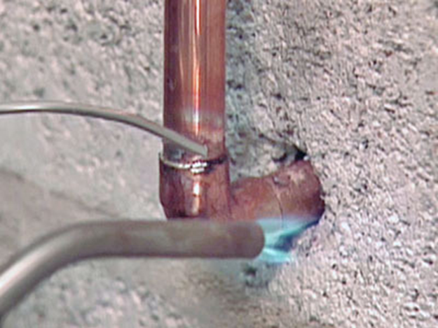
WATER QUALITY – LEAD & COPPER
Practice
Lead Results (ppb, ug/L):
  <5, 7, 13, <5, 3, 8, <5, 17, 15, <5
Copper Results (ppb, ug/L):
  129, 1402, 876, 564, 345, 1299, 1395, 290, <10, <10
What is the 90th percentile result for lead and for copper?
Does the PWS exceed the AL for lead, copper, both, or neither?

Slide 63
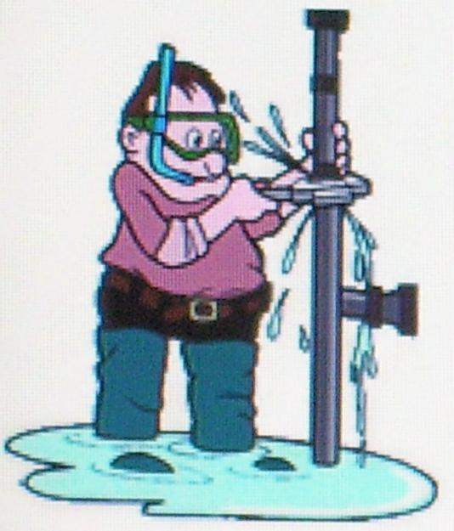
WATER QUALITY – LEAD & COPPER
What happens if a PWS exceeds the AL for lead or copper?
  Corrosion control treatment
  Public education and notification
  Water quality parameter testing
  Possible lead line replacement

Slide 64
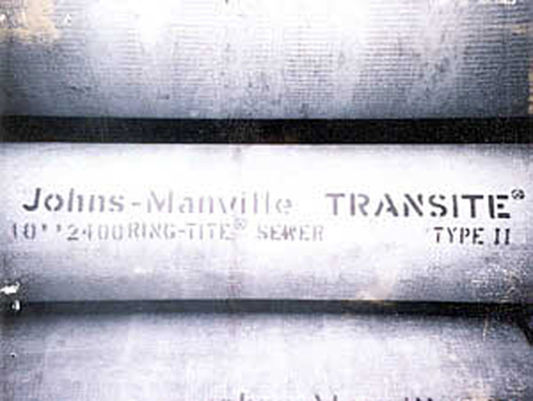
WATER QUALITY - ASBESTOS
Distribution System Sampling
  Required for COM, NTNC that contain asbestos piping in their distribution systems
  Samples are due once every 9 years.
Source Sampling
  Required for COM, NTNC at the source for sources in naturally occurring asbestos formations
  Samples are due once every 9 years.

Slide 65
WATER QUALITY –
DISINFECTION BYPRODUCTS (DBPS)
Disinfectants (chlorine, chloramines, chlorine dioxide) react with naturally occurring material in the water to create byproducts harmful to human health.
Disinfection Byproduct (DBP) monitoring
  Required for COM, NTNC that disinfect
Types of Byproducts
  Chlorine forms total trihalomethanes and haloacetic acids.
  Ozone forms bromate.
  Chlorine dioxide forms chlorite.

Slide 66
WATER QUALITY –
DISINFECTION BYPRODUCTS (DBPS)
Compliance is based on the average of results at each sampling location.
Maximum Contaminant Levels (MCLs)
  Total Trihalomethanes (TTHMs) = 80 ppb (0.080 mg/L)
  Haloacetic Acids (HAAs) = 60 ppb (0.060 mg/L)
Sampling frequency:
  Sampling varies from quarterly to annually based on the nature of the PWSs sources and population served.
  Reduced monitoring is allowed based on sample results. However, only very small groundwater PWSs (less than 500 population) will be reduced to every 3 years.

Slide 67
WATER QUALITY –
DISINFECTION BYPRODUCTS (DBPS)
A sampling plan is required!
  The number of samples is based on the population served.
  Must submit a sampling site plan for PWS that did not do the IDSE (Very Small Systems, 40/30 waiver)
Consecutive PWSs are on the same sampling frequency and start date as the largest PWS in the group.

Slide 68
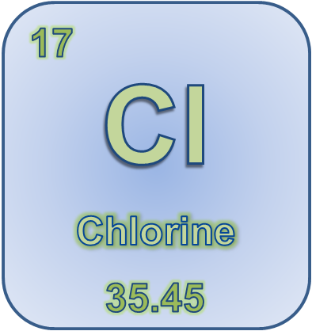
WATER QUALITY – DISINFECTION BYPRODUCTS (DBPS)
Maximum Residual Disinfection
Level (MRDL) of 4.0 mg/L
Groundwater PWS measure residual 3 times/week where coliform samples are taken
Surface water plants must continuously monitor disinfectant residuals. Grab samples are allowed for PWS serving less than 3,300 people if approved by DDW.

Slide 69
WATER QUALITY –
DISINFECTION BYPRODUCTS (DBPS)
There is additional monitoring for Conventional Surface Water Treatment Plants:
  Raw water alkalinity
  Raw and finished water Total Organic Carbon (TOC)
Submit quarterly reports to DDW due by the 10th day following the end of the quarter.

Slide 70
WATER QUALITY – TREATMENT REPORTS
Chlorination, Fluoridation Report Forms
  Daily readings
  Volume of water treated
  Amount of chemical used, residual
Surface Water Treatment Plant Report Forms
  Continuous turbidity readings
  Clearwell is an appropriate place to take turbidity samples.
  Volume of treated water
  Type and amounts of chemicals used
  Continuous chlorine residuals

Slide 71

WATER QUALITY - FLUORIDE
Maximum Contaminant Level (MCL) = 4.0mg/L
Secondary MCL = 2.0mg/L (If a PWS is over this level, they must notify the public.)
Plan review & operating permit
Monthly reports
Field test = SPADNS for daily fluoride residual concentrations
Fluoride chemical addition is currently on a county basis
Treatment Chemicals
  Sodium Fluoride
  Fluorosilicic acid
  Sodium silicofluoride
  Sodium fluorosilicate

Slide 72

WATER QUALITY - STANDARDS
All chemical added to drinking water must be National Sanitation (NSF) Standard 60 approved.
Turbidity for groundwater source not UDI is 5.0 NTU.
Turbidity for surface water/UDI treated water is less than or equal to 0.34 NTU in 95% of the results, max 1.0 NTU.
Chlorine MCL is 4.0mg/L (MRDL)
Reservoir disinfected to AWWA C 652 Standard

Slide 73
WATER QUALITY – SOURCE SAMPLES
May group sources if:
  They mix before entering the distribution system.
  2 or more wells in the same aquifer
PWS required to keep chemical results for 10 years
Report results to DDW within 40 days of receipt
Asbestos
Inorganics & Metals
Nitrate
Nitrite
Sulfate
VOCs
Pesticides
Radionuclides

Slide 74
WATER QUALITY – SOURCE SAMPLES
Inorganics & Metals
Systems that must sample | Initial sampling frequency | Reduced sampling frequency
COM, NTNC | SW = Annual GW = Every 3 yrs | Once every 9 yrs based on all previous rounds <75% of MCL
Sulfate
Systems that must sample | Initial sampling frequency | Reduced sampling frequency
TNC | Every 3 yrs | Once every 9 yrs based on all previous results <75% of MCL

Slide 75
WATER QUALITY – SOURCE SAMPLES
Nitrate
Systems that must sample | Initial sampling frequency | Reduced sampling frequency
COM, NTNC, TNC | SW = Quarterly GW = Annual | SW = Annual NO OTHER REDUCTIONS ALLOWED
Nitrite
Systems that must sample | Initial sampling frequency | Reduced sampling frequency
COM, NTNC, TNC | Just one sample. . . If <0.5mg/L = waiver If >0.5mg/L = quarterly | Waiver = No sampling required

Slide 76
WATER QUALITY – SOURCE SAMPLES
Asbestos
Systems that must sample | Initial sampling frequency | Reduced sampling frequency
COM, NTNC (if the source is vulnerable) | Once every 9 yrs | No sampling required
*Measured in picocuries per liter (pCi/L)
Radionuclides
Systems that must sample | Initial sampling frequency | Reduced sampling frequency
COM | Quarterly for 1 year | Every 3, 6, or 9 yrs, depending on initial results

Slide 77
WATER QUALITY – SOURCE SAMPLES
VOCs (Volatile Organics)
Systems that must sample | Initial sampling frequency | Reduced sampling frequency
COM, NTNC | Quarterly | Annual, Once every 3 yrs (susceptibility waiver), Once every 6 yrs (use waiver)
Pesticides
Systems that must sample | Initial sampling frequency | Reduced sampling frequency
COM, NTNC | Quarterly | Once or twice every 3 yrs (susceptibility waiver), Not required (use waiver)

Slide 78

WATER QUALITY – SOURCE SAMPLES
Waivers
  Reliably & Consistently
    Based on past data
  Susceptibility
    Based on if the source is vulnerable and past data
  Use
    Based on if the contaminants are used, trans-ported, manufactured or stored in the source area

Slide 79
WATER QUALITY – REPORTING TO DDW
It is the PWS’s responsibility to report data to DDW.
Monthly operational report forms go to DDW.
Bacterial water quality data must be received by DDW by the 10th day of the month following receipt of analysis.
Chemical water quality data must be received by DDW within 40 days of receipt of analysis.
Unsatisfactory analytical results must be reported to DDW by phone as soon as possible.

Slide 80
CONSUMER CONFIDENCE REPORTS (CCR)
Annual water quality report due by July 1 to DDW, wholesalers due by April 1.
Required for all COM systems
DDW must receive:
  A copy of the CCR by July 1
  A certification letter describing how the CCR was delivered to customers by October 1

Slide 81

CONSUMER CONFIDENCE REPORTS (CCR)
The CCR must contain:
  Date prepared, PWS identification number
  System information (phone, meetings)
  Source information (names)
  Definitions (MCL = maximum contaminant level)
  Table of detected contaminants
  Violations (if any)
  Additional health information
  Variances & exemptions (if any)
  Uncorrected Significant Deficiencies

Slide 82
PUBLIC NOTIFICATION
Violation Types
  Tier 1
    Acute contaminants = confirmed E.coli coliform bacteria acute violation, nitrate, nitrite
    Mandatory health effects language
    Notify DDW & customers within 24 hours
  Tier 2
    Non-Acute Contaminants = chemical MCLs,
    Treatment technique=Failure to perform assessment
    Mandatory health effects language
    Notify DDW & customers within 30 days
  Tier 3
    Monitoring & reporting violations
    Notify customers within 1 year
    Failure to correct significant deficiency\sanitary defect
  Continue notification every 3 months for as long as the violation exists

Slide 83
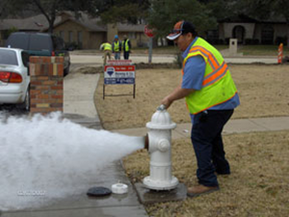
OPERATOR CERTIFICATION
Required for all COM and NTNC systems AND any PWS that treats surface water or UDI water.
How do I become certified?
  Tested Certificates
    Pass the op cert exam, specific the to operator
  Grandfather Certificates
    PWS is in compliance, specific to the operator and PWS, non-transferable, operator must have worked for the PWS for a minimum # of years

Slide 84

OPERATOR CERTIFICATION
Certificates
  Operator
    Working for a PWS
  Specialist
    Not working for a PWS
Certification Levels
  Treatment – 4 levels
    T1, T2, T3, T4
  Distribution – 5 levels
    SS, D1, D2, D3, D4

Slide 85

OPERATOR CERTIFICATION
Required Experience
  Unrestricted
    Experience: from 0 to 10 years
    The exam cannot measure experience (what you can do)
  Restricted
    Certified at or above grade level but lacks the required experience

Slide 86
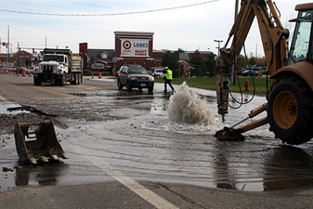
OPERATOR CERTIFICATION
Direct Responsible Charge (DRC)
  All DRC operators must be certified at the level of the PWS.
  They make independent decisions which may affect the quantity or quality of the water.
  The supervisor’s signature is required.
  If all DRC operators leave a PWS
    DDW must be notified within 10 days
    Obtain a new certified operator within 1 year

Slide 87
OPERATOR CERTIFICATION –
REQUIREMENTS FOR UNRESTRICTED LICENSE
Grade Level | BS degree | AS degree | High School | Non-High School
DRC + Years | DRC/Total (Years) | DRC/Total (Years) | DRC/Total (Years) | DRC/Total (Years)
SS & 1 | 0/1 | 0/1 | 0/1 | 0/1
2 | 0/2 | 0/2 | 0/2 | 0/3
3 | 1/2 | 1/2 | 2/4 | 3/6
4 | 2/4 | 2/6 | 4/8 | 5/10

Slide 88
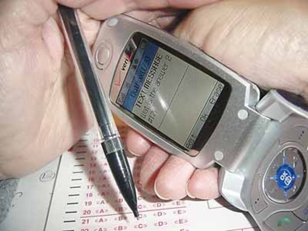
OPERATOR CERTIFICATION
Operator Responsibilities
  Ensure safe and adequate supply of water
  Be current with monitoring & reporting requirements
  Report to DDW unsatisfactory water quality and breakdowns in treatment
  On call operators must be within 1 hour travel time
  24-hour PWS – Each shift must have an operator certified at the level of the PWS
A certificate may be revoked:
  For data falsification
  For disregard of public health and safety
  Cheating on an exam

Slide 89
OPERATOR CERTIFICATION
Renewal
  All certificates are renewable every 3 years (grandfather, operator, specialist)
  Continuing Education Units (CEUs) are required for renewal. 1 CEU = 10 hours
2 CEUs = 20 hours
Small System
T1 & D1
T2 & D2
3 CEUs = 30 hours
T3 & D3
T4 & D4

